Slide 1



MARKET
SIMULATIONS
Data Science R&D
Data Science
Commecial Analytics Solutions
HHDDA

Slide 2


Content
01
Overview
02
Opportunity
03
Solution
04
Stakeholders
05
Team
06
Next Steps
Notes:
Let us first look at the Overview of the proposal. Then the contents are divided into sections on:
Opportunity.
Solution.
The Stakeholders.
The Team.
And the Next Steps.

Slide 3


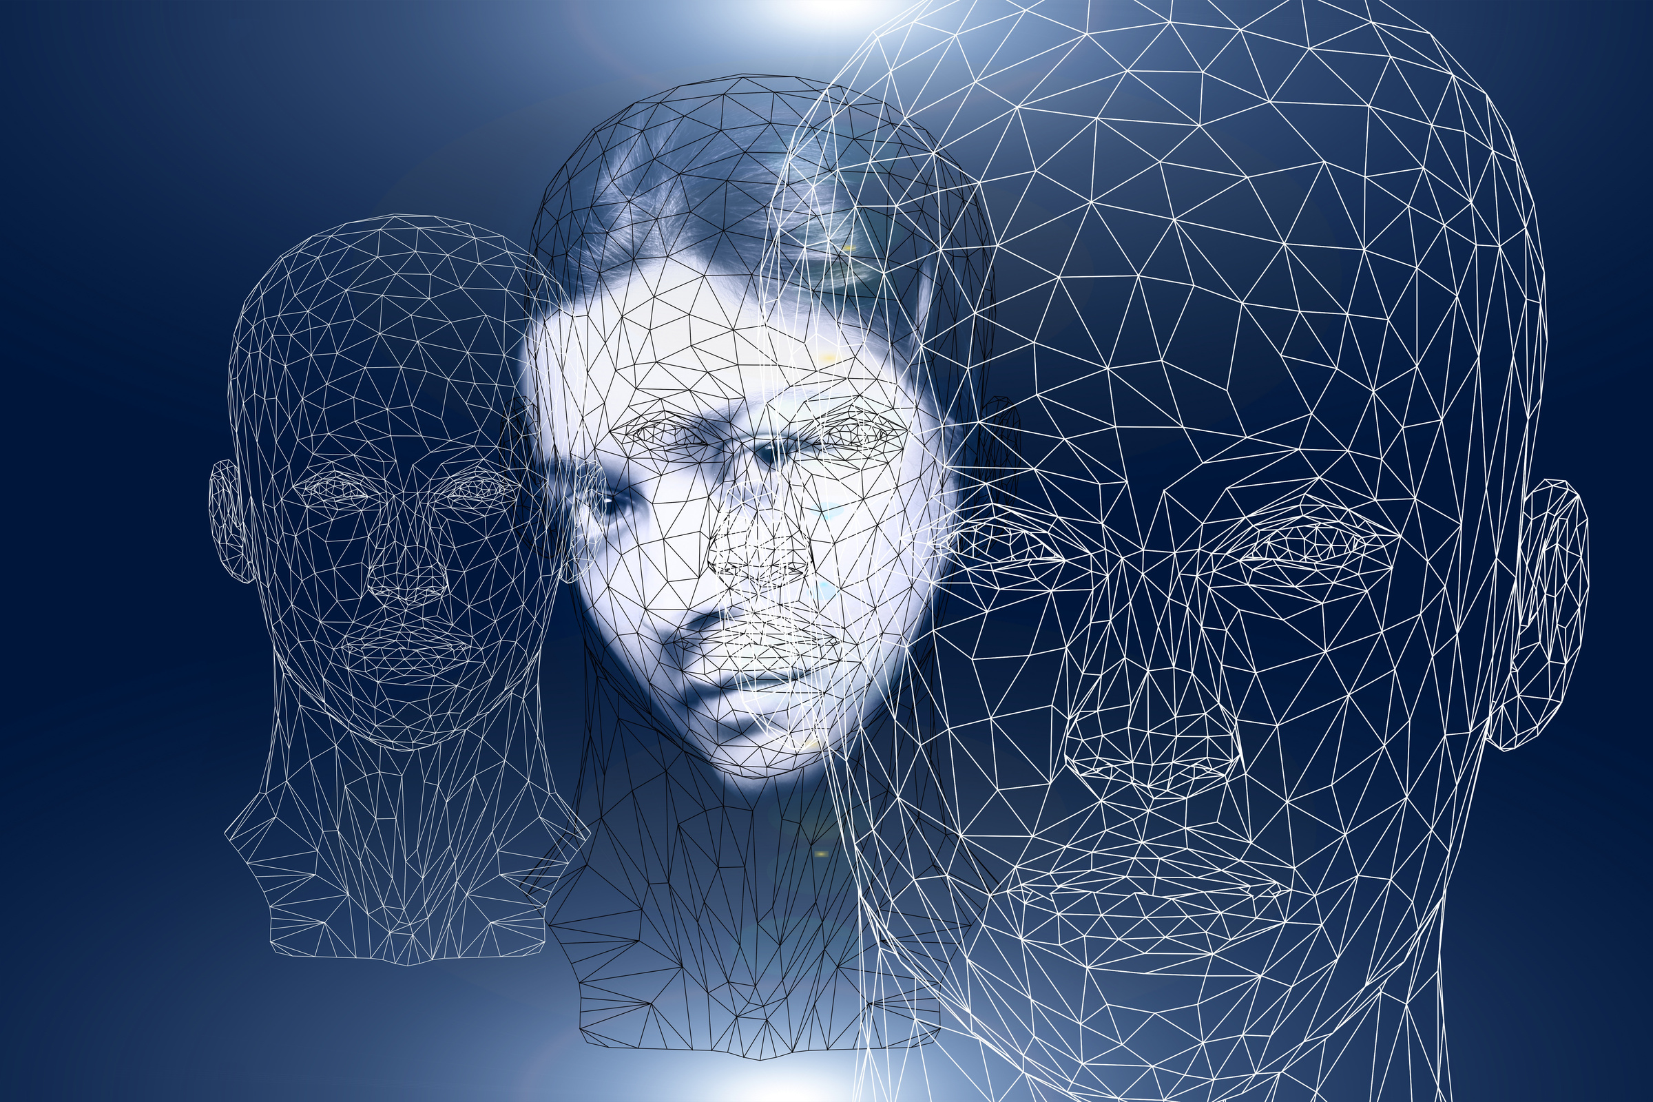
Overview
Computer based simulation of dynamic market environment of a brand can illuminate how complex marketing phenomena emerges from individual behaviors of various stakeholders.
Notes:
Brand sales depends on groups of entities that operate in a dynamic market environment with complex interactions among them. Examples of the entities are HCPs, Consumers, Government Policies, Brand efficacy and safety, Managed Care etc.
Optional:
Computer based simulation of a brand's dynamic market environment can illuminate how complex marketing phenomena emerges from individual behaviors of various stakeholders and entities.
Examples of the entities are HCPs, Consumers, Government Policies, Brand efficacy, Managed Care etc.

Slide 4

Overview
Objective is to develop agent based computer simulation models to address the macro and micro financial outcomes of various brand marketing strategies.
The idea here is like building Flight Simulators for Pilot Training.
Notes:
Our objective here is simulate these behaviors virtually in a computer, so that a marketer can observe the estimated sales trends arising from different marketing strategies applied within the dynamic environment. The learnings help to fine tune the marketing strategies.
We propose to apply “Agent Based Simulations (ABM)” as the underlying technique to simulate the market conditions.
The idea here is similar to building Flight Simulators for Pilot Training.

Slide 5




Opportunity
Targeting & Promotions
Controllable
Internal
01
Managed Care Position
02
A brand’s sales is impacted by multiple factors.
03
Prescribing Information (PI)
Estimating sales impact by these factors and the interactions between them will help in developing effective marketing strategies.
Competition
04
Not Controllable
External
Notes:
Let us consider an example.
A brand’s sales is impacted by multiple factors.
The internal controllable factors include HCP and Consumer Targets and corresponding Promotions, Formulary Positions etc.
The external non controllable factors include Brand Efficacy & Prescribing Information, Competition etc.
Currently, we study and model the impacts of such factors on resulting sales independently by respective teams of experts. The interactions are not completely captured.
In reality, these factors depend on each other and a complex interaction among them defines the market environment and the resulting sales.
A clear opportunity exists in estimating sales impact by these factors and, more importantly, the interactions between them. This will help in developing effective marketing strategies.

Slide 6









Solution
Agent Based Model
Agent Based Modeling is a simulation technique that mimic complex market environment and interactions between several factors.
HCPs
Targets & Promotions
Competition
Marketers simulate multiple marketing strategies, study the sales outcomes, and selects most effective strategy to maximize sales.
Consumers
Managed Care Positions
Prescribing Information [PI]
Notes:
Agent Based Modeling is a simulation technique that could help in mimicking complex market environment.
Once modeled and validated, marketers then virtually simulate multiple marketing strategies and study the sales outcomes.
This enables the marketer to choose most effective strategy to maximize sales.
We start with creating thousands of virtual HCPs and Consumers.
Each HCP is assigned attributes such as Specialty, Group Practice, Location, Plans, Promotions and Targeting status.
Consumer attributes such as age, gender, location, insurance plan, social network and promotions are assigned.
Similarly Brand profiles, Prescription policies, Formularies are defined as entities.
Then behaviors and interactions between them are specified and models are validated against historical data.
We then run the simulation for an year for various user defined marketing strategies.
The output is the brand sales trend at both national as well as defined sub-segments.

Slide 7

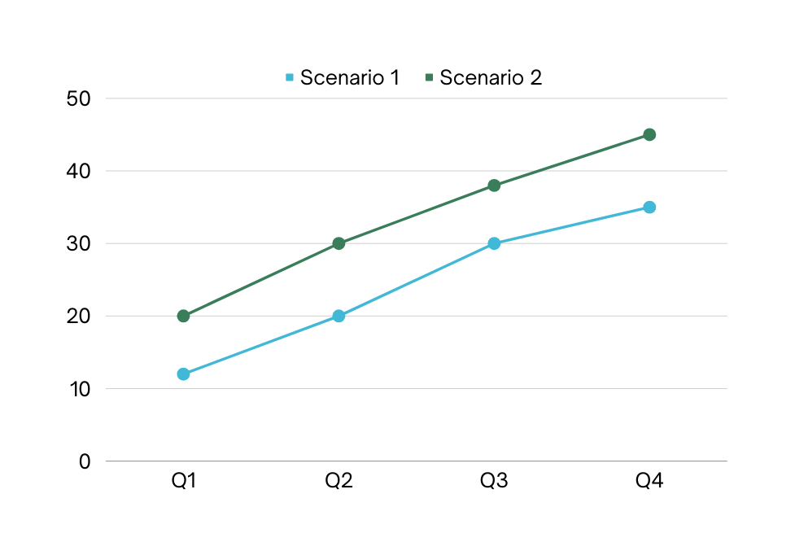


Outcomes
Results: Brand Sales Trend
Agent Based Model
Targeting
Scenario 1 Spend: $X | Scenario 2 Spend: $1.4X
Top PCPs with a set of HCP Promotions | TOP PCPs and Specialists with increased promotions
Consumers : Adults 50+ and a set of HCC Promotions | Same as Scenario 1
Commercial Plans: Tier 2 formulary: 20% Rx Prior Auth: 40% Rx | Commercial Plans: Tier 2 formulary: 35% Rx Prior Auth: 35% Rx
Heavy Competition | Same as Scenario 1
Estimated yearly sales for scenario two is 25% more than first. Spend is 40% more due to higher discounts and promotions.
Conclusion: Considering future growth potential, scenario 2 is preferred even though the spend is higher now.
Notes:
A marketer runs two scenarios and observes resulting sales.
In Scenario 1: Target top PCPs with a set of HCP promotions. Targeted consumers are Adults 50+.
20% of commercial plans have preferred tier and 40% need prior authorization. Competition is heavy.
In Scenario 2: Target top specialists and PCPs. 35% of commercial plans have preferred tier and 35% need prior authorization.
The marketer runs simulation that outputs estimated sales for one year.
Results show second scenario yields 25% more sales than first. Spend is 40% higher than first scenario.
In conclusion, Considering future growth potential, scenario 2 is preferred even with higher spend.

Slide 8




Stakeholders
Target Audience #1
Target Audience #2
Brand Marketers
Commercial Operations & Anaytical Teams
Notes:
Simulation helps the brand team, the primary stakeholders, to adjust various market levers and fine tune their marketing strategy.
Commercial Operations and Analytical teams who are responsible for strategy & implementation are also the target audience for simulation.

Slide 9




AGILE TEAM
Success is dependent on tight integration between Brand and Simulation teams.
Project Owners
Core Team
Extended Team
Simulation CoE Lead
Brand Director
Simulation Implementer(s)
One representative each from
DS BU
CAS Targeting
CAS Managed Care
IA&IO
BEA
Simulation CoE Lead
Brand Marketing Director
IT, DET, Media, Forecast team representatives
Notes:
A tight integration between brand and simulation team is needed for successful implementation.
The agile pod has Simulation CoE Leader and Brand leader as project owners.
To thoroughly understand and implement brand dynamics, a group of corresponding subject area experts are needed as core team members.
During initial and delivery stages, core team meets twice a week. During implementation phase it would be once a week.

Slide 10
NEXT STEPS

Slide 11





2025 - Scale
Simulation UI & Executions for ~10 Brands (US/Ex-US)
Q4 2024 - One Ex-US Market
A market with data limitations. Tool Implementation
Timeline & Next Steps
2024 - Growth Phase
2025 - Scale
Q3 2024 - Gardasil 9 Adult
Manual & Commercial Tool Implementations
Q1 & Q2 2024 - V116 Launch Planning
Manual implememnataion
Notes:
Year 2024 will be a growth phase with few implementations. Scaling to multiple brands is scheduled for 2025.
During first half of 2024, supporting V116 US Launch Planning will be our first simulation project. V116 launches in mid 2024. Objective is to test, learn and adapt.
In Q3 of 2024, US Gardasil9 Adult strategic plans will be studied. Selection of a commercial simulation tool will also be considered.
In Q4, Market Simulation for one Ex-US market will be added. Simulation would be particularly useful when such markets have data restrictions. Objective is to test and learn outside US. Usage of commercial tool will be explored in depth.
In 2025 we plan to scale to 10 brands within US and Ex-US markets.

Slide 12


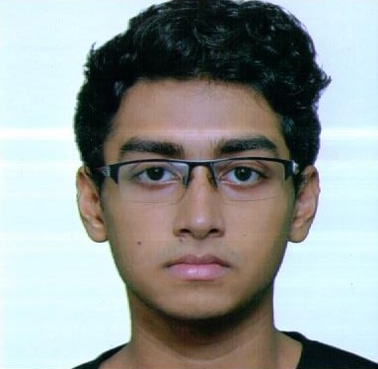

Data Science R&D Simulation Team
Senthil Murugan
Sahil Poonatar
TBD
Lead / Director
Data Scientist
Data Scientist

Slide 13

THANK YOU

